Slide 1
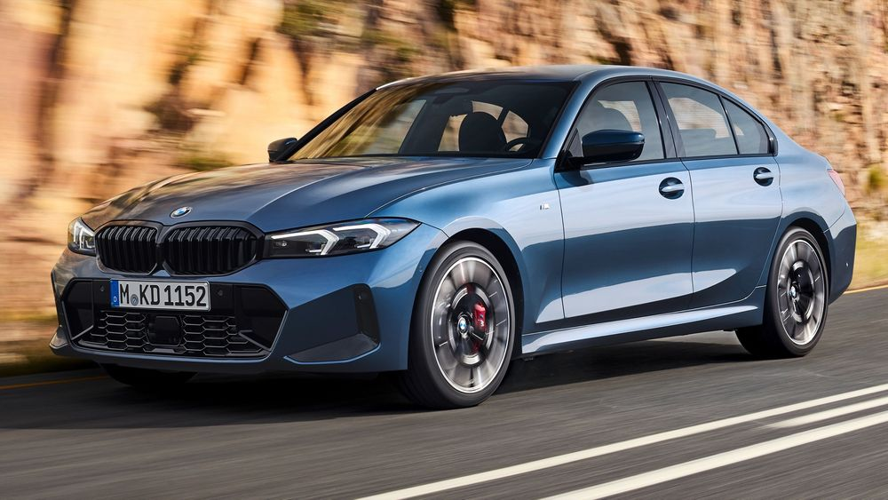
BMW SALES DATA
BY NABILASHAIKH

Slide 2
About dataset
Total 50,000 rows and 11 columns.
categorical column are 5,
numerical column are 5
Geographical column 1.
objective
Objective to know about which model has highest sales.

Slide 3
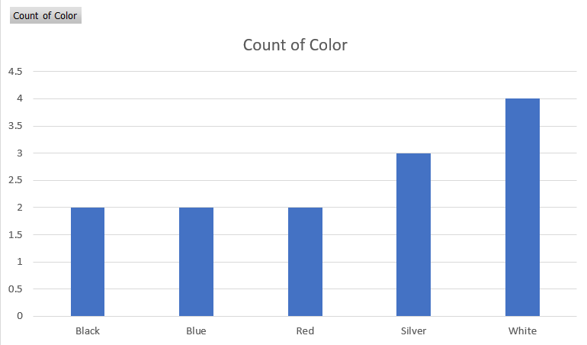
univariant analysis
white colour is the highest colour of model.

Slide 4
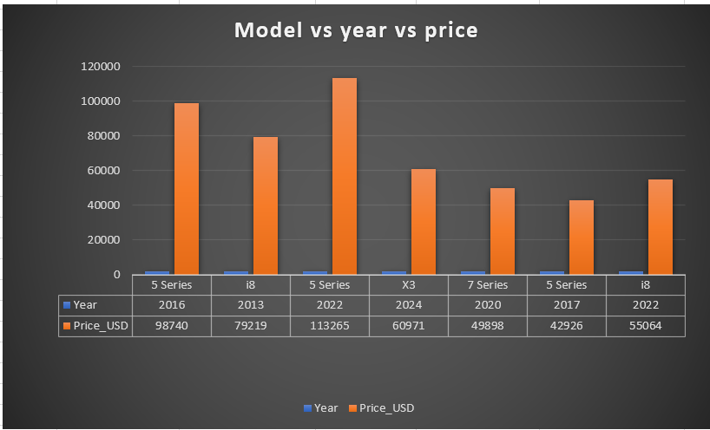
In which year were the BMW prices the highest, and in which year were they the lowest?
Model | Year | Price_USD
5 Series | 2016 | 98740
i8 | 2013 | 79219
5 Series | 2022 | 113265
X3 | 2024 | 60971
7 Series | 2020 | 49898
5 Series | 2017 | 42926
i8 | 2022 | 55064

Slide 5
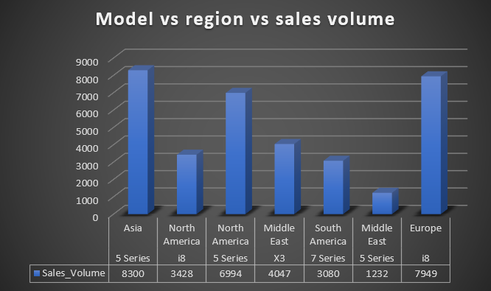
multivariant analysis
which model has the highest sales volume and in which region?
Model | Region | Sales_Volume
5 Series | Asia | 8300
i8 | North America | 3428
5 Series | North America | 6994
X3 | Middle East | 4047
7 Series | South America | 3080
5 Series | Middle East | 1232
i8 | Europe | 7949

Slide 6
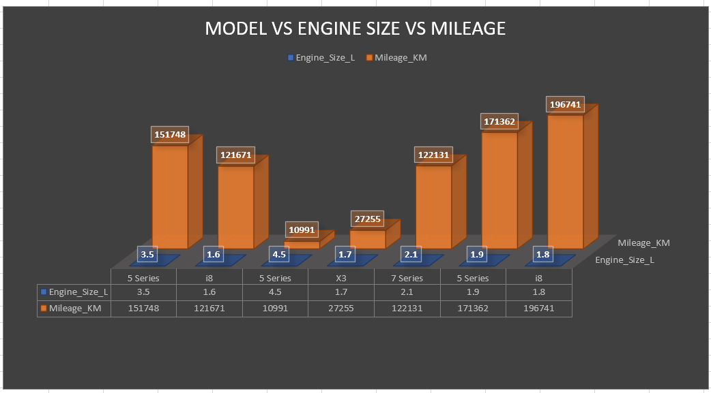
Does engine size affect mileage for BMW Models ?
Model | Engine_Size | Mileage_KM
5 Series | 3.5 | 1.52 L
i8 | 1.6 | 1.22L
5 Series | 4.5 | 0.11L
X3 | 1.7 | 0.27L
7 Series | 2.1 | 1.22L
5 Series | 1.9 | 1.71L
i8 | 1.8 | 1.96L

Slide 7
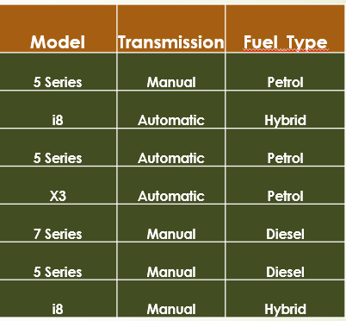

Slide 8
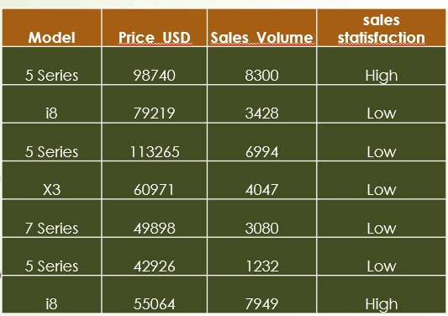

Slide 9
Conclusion
BMW has profit in Aisa, North America, Europe due to highest sales .
Less sale in middle east,
So in simple words BMW is in profit by price and sales also.
Thank you all of you for your attention .

